Slide 1


WP5 Demonstrator
Review Meeting
16/01/2014 - Munich

Slide 2


Overview
Current status of WP 5
Draft proposal of the API
Test Environment description
Result of the meeting with GE in December 2013
Discussion on open tasks
Planning consolidation for 2014

Slide 3
Main objectives of the WP5 part
Provide a Demonstrator to show the results of the openETCS project (EVC code mainly)
Provide a Test Environment to prepare and run scenarios and produce test reports
Provide a non vital Reference Unit

Slide 4
Current status of the main tasks (1)
5.1 Functional Specification
Provided for comments in October 2013
No comments received
Then considered as accepted
5.2.A Production of an ON BOARD Simulator Iteration 1
In progress
Definition of our API, a draft will be presented

Slide 5
Current status of the main tasks (2)
5.2.A Production of an ON BOARD Simulator Iteration 1
OBU (PC)
ERSA EVC Baseline 3
Non formal
API
CTRL/
CFG
ODO
TIU/
BIU
BAL
LOOP
RAD
STM
DMI
JRU
Logical interface (TCP / IP)

Slide 6
Current status of the main tasks (3)
5.2.B Production of an ON BOARD Simulator Iteration 2
Not started yet
5.3 Production of Test Environment
Started, related to task 5.2 A
Tasks 5.4 to 5.9
Not yet started
Tasks 5.7 to 5.9 : first meeting took place

Slide 7
API Proposal (1)
The API will allow EVC communicating with the outside world
Sending and receiving data to and from peripherals:
From and to (calibration) Odometer
From and to Train and Brake Interface Unit
From Balise Transmission Module
From Loop Transmission Module
From and to EURORADIO module
From and to Specific Transmission Module
From and to Driver Machine Interface
To Juridical Recording Information
Additional commands may also be needed to control the EVC (initialisation, status, …)

Slide 8
API Proposal (2)
Each peripheral will have a simple function set
For reading data from peripheral
For writing data to peripheral
Additional commands to control the peripherals (initialisation, status, error reporting, …)

Slide 9
Technical details (1)
Protocols, exchanged data formats shall exclusively rely on SRS definitions and format
Odometer: subset 35 - §12
TIU and BIU: subset 34
Balise and Loop: subset 26 - §7 and §8
Radio: subset 26 - §7 and §8, subset 37 - §7
STM: subset 35 - §5 and subset 58
JRU: subset 27 - §4
DMI: ERSA implementation will be proposed

Slide 10
Technical details (2)
More complete description is available in a draft documentation which is published on GitHub
Should be reviewed and improved !
Could be updated following other WP progress and while implementing
Implementation in C language is ongoing: will match what is currently used in ERSA EVC

Slide 11
Test Environment (1)
Works are ongoing: bound together at the moment with the ERSA EVC, but will become a standalone application with the result of iteration 1
PC
ERSA EVC Baseline 3
CFG
ODO
TIU
BAL
LOOP
RADIO
STM
DMI
JRU
PC
ERSA EVC Baseline 3
Scenario controller
API
scenarios
Test
results
Logical interface (TCP / IP)
PC
CFG
ODO
TIU
BAL
LOOP
RADIO
STM
DMI
JRU
Scenario controller
scenarios
Test
results

Slide 12
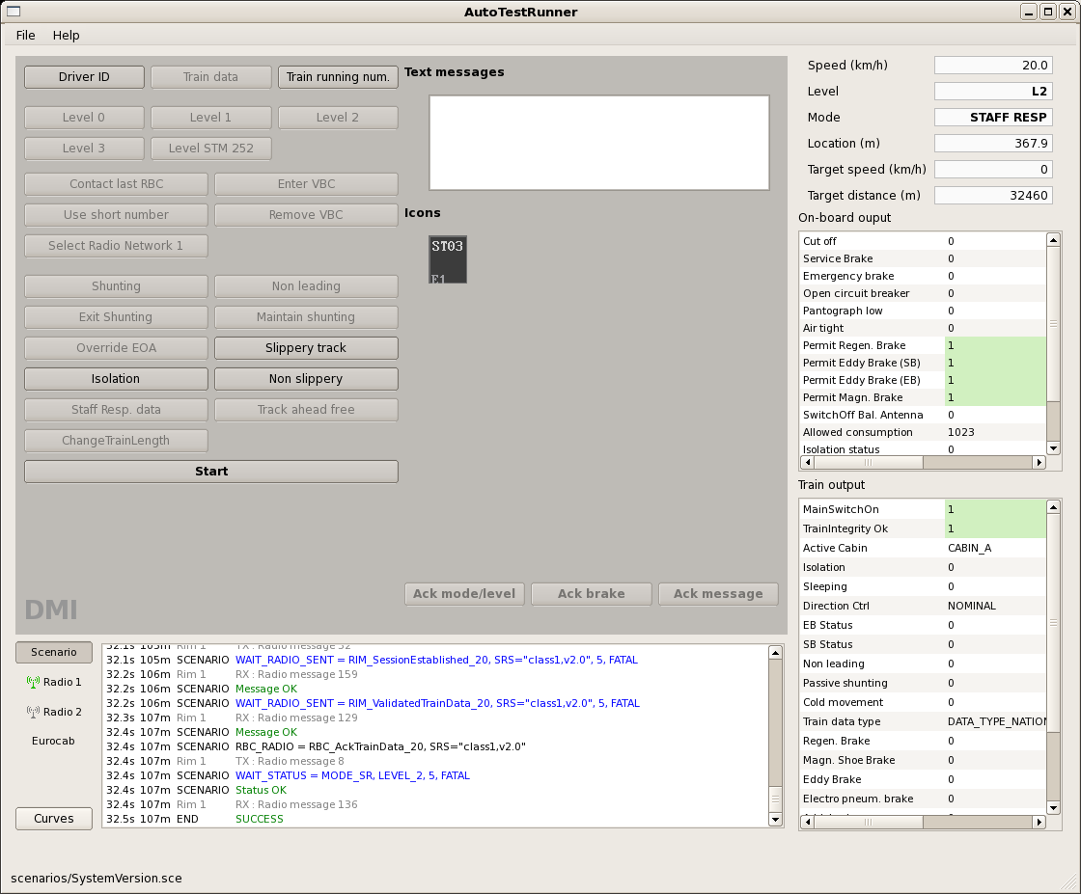
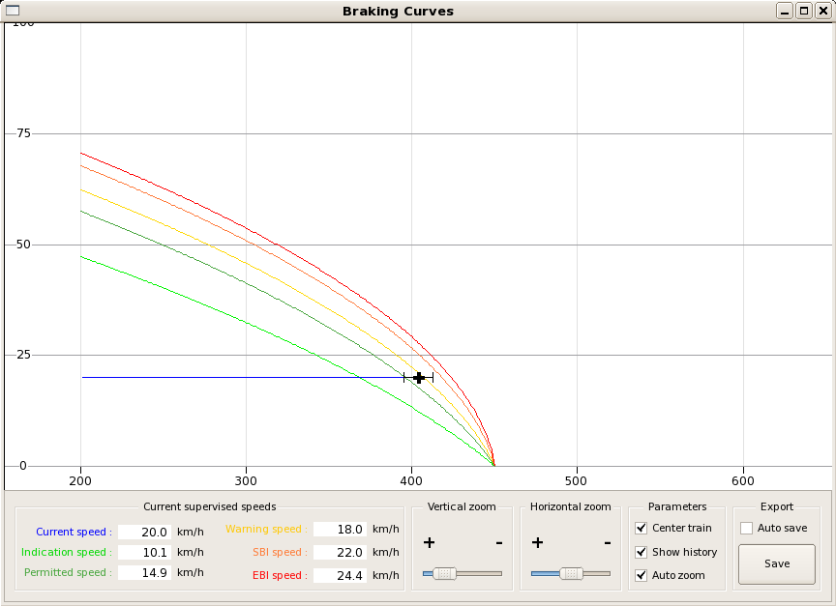
Test Environment (2)
Can already execute some simple scenarios and is already used internally by ERSA
But will require some work to suit all the requirements:
Scenario format adaptation
Test result templates
…

Slide 13

Report on meeting with GE (1)
(NON) VITAL
PLATFORM
ERSA EVC Baseline 3
Non formal
Generated code
API
CTRL/
CFG
ODO
TIU/
BIU
JRU
STM
RAD
LOOP
BALI
DMI
Physical interface (FFFIS or FIS)
Adapter
TEST
ENVIRONMENT
(SUBSET 094)
Train Movement Simulator
national system simul.
Trackside ETCS
simul.
Driver simul.

Slide 14
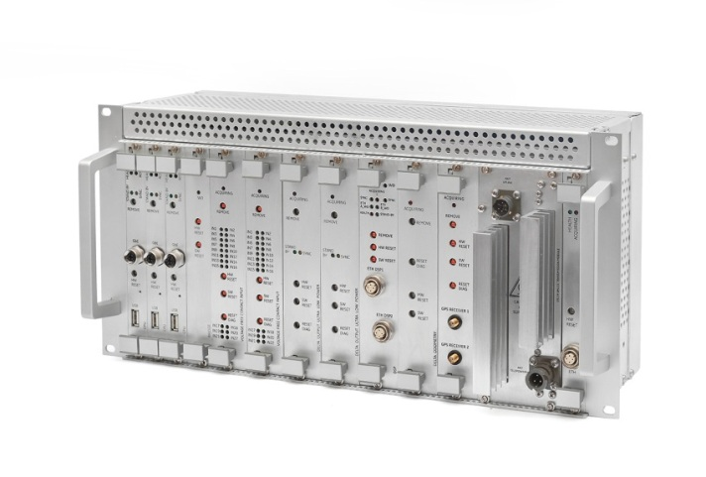
Report on meeting with GE (2)
GE tasks:
provision of hardware platform and peripheral on board equipment
provision of development environment for C language
provision of wrapper for EVC code integration
technical support
ERSA tasks:
integration of EVC code
interaction with wrapper
tests
Peripherals and hardware resources
Wrapper
API
EVC

Slide 15
Open tasks (1)
5.2.B On Board simulator – iteration 2
Use of generated code provided in WP3
Proposal :
Define together priorities for merge of code
Start with integration of braking curves
Balise telegram management
…

Slide 16
Open tasks (2)
5.3 Production of test environment
Need to have a template definition for test scenario (defined in 5.4):
Proposal :
We can provide to the project our current definition as a starting point
Need to have a template definition for test report
Proposal :
We can provide to the project our current definition as a starting point (log and JRU data)
More work will be needed

Slide 17
Open tasks (3)
5.4 Data preparation (DLR leader)
Track and train data must be provided
Refine template of test scenario (collaboration with other partners), and test environment if needed
5.6 Data exploitation (DLR leader)
Refine template of test report (collaboration with other partners), and test environment if needed

Slide 18
Planning consolidation for 2014
March 2014: First iteration of OBU Simulator
April 2014: Technical discussions with GE
May 2014: Input scenarios
July 2014: Preliminary test Environment
December 2014: WP5 Demonstrator ready (first version with combination of ERSA EVC code and generated code from WP3)

Slide 19
- Thank you for your attention
- Questions & Answers

